Slide 1
Autonomous and Accommodating Transactions

Slide 2
Autonomous and Accommodating Transactions
The transaction made in the Balance of Payments can be categorized into two parts: Autonomous Transactions and Accommodating Transactions.

Slide 3
Autonomous Transactions
These are economic transactions that are made to earn profits, not to bridge the gap in the BoP. In simple words, sometimes there are situations when there is a BoP deficit in that case the government has to make certain transactions to correct it, but the autonomous transactions are not made for that purpose. The purpose here is to maximize profits.
Thus, it can be said that these transactions are independent of BoP.
These transactions are also called "above the lines", as they are made to earn profit.
These transactions can be made by the private sector and the government.
Depending on the type of transaction, autonomous transactions occur on both current and capital accounts. In the case of the current account, merchandise imports and exports are autonomous items and in the capital account receipts and payments of long-term loan taken or provided by private individuals comes under autonomous items.
When the autonomous receipts exceed the payments, the BoP balance is considered to be in surplus. When autonomous payments exceed receipts, the BoP is considered to be in deficit.
Example: If a Multinational Company (MNC) makes Foreign Direct Investment (FDI) in our country, the main purpose behind this is to earn profit. This transaction is not made to correct the balance and is independent of BoP.
The main autonomous items are as follows:
Trade in Goods and Services
One-sided Transactions
Capital Transfers

Slide 4
Accommodating Transactions
These are economic transactions that are made to bridge the gap in the BoP. In simple words, sometimes there are situations when there is a BoP deficit in that case the government has to make certain transactions to correct the BoP, these transactions are called accommodating transactions. Thus, it is undertaken to establish the balance of payments identity.
It can be said that these transactions are dependent on BoP. It means that these are based on the state of BoP and not made for the profit motive.
These transactions are undertaken as the result of autonomous transactions, this means that it is made to correct the disequilibrium caused by the autonomous transactions. Thus, it is also called "below the lines".
These transactions can only be made by the country's government.
Autonomous transactions take place on capital accounts. It can take place in the form of borrowings from international institutions and official foreign reserves of the country.
It must be noted that there is no movement of goods and services across the borders in this case. It takes place by the movement of official reserves of the country.
Example: If there arises a deficit in the BoP, then it is corrected by the borrowings from the outside world.
The main accommodating items are as follows:
Borrowing of government from the International Monetary Fund (IMF) or other Foreign Financial Institutions
Foreign Exchange Reserves

Slide 5
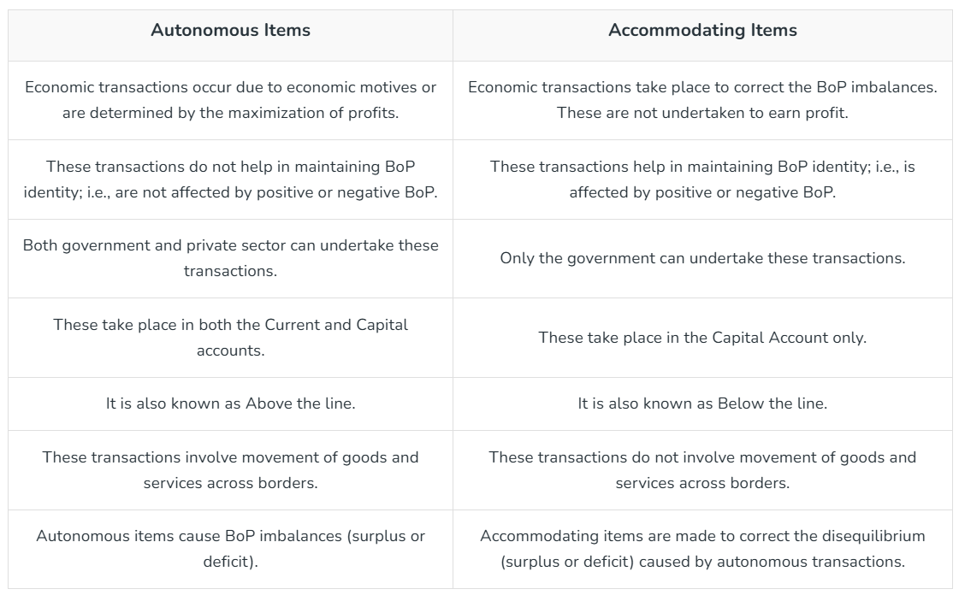
Autonomous Items vs Accommodating Items

Slide 6
While preparing the Balance of the Payment account, it must be ensured that the BoP balances, i.e., all the credit items are equal to the debit items. But when international transactions are not recorded accurately, there arise some errors and omissions in BoP.
For example, there is an error in converting the price of one currency into another currency, i.e., conversion of dollars into rupees. The error may arise due to compiling or collecting the data from different sources. Thus, there is a need to understand these errors and the reasons for these errors and omissions.

